Slide 1
Acid - Base Problems Case Presentation
MOHAMMED YOUNUS AL ATBEE
Consultant nephrologist and physician
Assistant professor of medicine and nephrology
Interactive session

Slide 2
Definitions
The acidity or alkalinity of a solution is determined by its Hydrogen ion concentration
Acidosis indicates an increase in the Hydrogen ion concentration
Alkalosis indicates a decrease in the Hydrogen ion concentration
Normal ABGs
Normal [H+] = 40 ηEq/L = Normal pH = 7.40
Normal PC02, 40 mmHg
Normal HC03, 24 meq/L

Slide 3
Henderson Equation
pC02
[H+] = k x ------------
[HCO3-]
40
[H+] = 24 x ------ = 40 ηEq/L
24

Slide 4
Acid Base Disorders
 | pH | H⁺ | PCO2 | HCO3-
Normal | 7.40 | 40 mEq/L | 40 mmHg | 24 mEq/L
Respiratory Acidosis | ⇩ | ⇧ | ↑ | ⇧
Respiratory Alkalosis | ⇧ | ⇩ | ↓ | ⇩
Metabolic Acidosis | ⇩ | ⇧ | ⇩ | ↓
Metabolic Alkalosis | ⇧ | ⇩ | ⇧ | ↑

Slide 5
ANION GAP AND DIFFERENTIAL DIAGNOSIS
Cations = Anions
MC + UC = MA + UA
MC – MA = UA – UC
ANION GAP = UA – UC
AG = Measured Cations - Measured Anions
AG = Na - ( Cl + HCO3) = 12 ± 2
OR ( Na+K ) – ( Cl + HCO3) = 16 ± 2

Slide 6
Loss of Alkali from the Body
Topamax

Slide 7
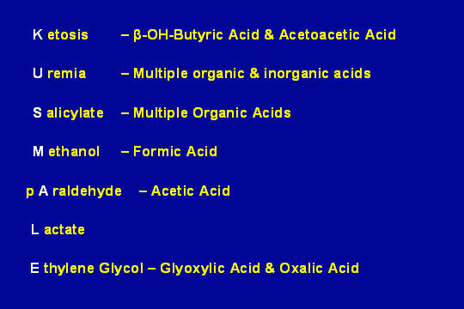
ANION GAP METABOLIC ACIDOSIS ( Addition of Acid; Normochloremic )

Slide 9
Case 1
60 year old male patient with glaucoma, prescribed Diamox by his ophthalmologist. 1 week into therapy, the patient became tachypneic, mildly confused, and suffered muscle weakness.
Na 136 Creatinine 1.1 mg
K 2.5
Cl 114
HCO3 10
ABG pH 7.24
pC02 25
pO2 90

Slide 10
Case 1: pH 7.24; pC02 25; HCO3 10 Na 136; Cl 114; K 2.5
Step 1. PH= 7.24 , low bicarb Acidemia
Metabolic Or Respiratory
PC02 < 40 mmHg ------ Not Respiratory
So it is Metabolic Acidosis
Step 2. Simple Vs. Mixed
Expected PC02= HC03 + 15=
= 10+ 15 =25
Simple Metabolic Acidosis
Step 3. Anion Gap : 136 – (114 + 10 ) = 12
Non Anion Gap Metabolic Acidosis

Slide 11
Case 1: pH 7.24; pC02 25; HCO3 10 Na 136; Cl 114; K 2.5
Step 1. PH= 7.24 Acidemia
Metabolic Or Respiratory
PC02 < 40 mmHg ------ Not Respiratory
So it is Metabolic Acidosis

Slide 12
Case 1: pH 7.24; pC02 25; HCO3 10 Na 136; Cl 114; K 2.5
Step 1. PH= 7.24 ,low bicarb Acidemia
Metabolic Or Respiratory
PC02 < 40 mmHg ------ Not Respiratory
So it is Metabolic Acidosis
Step 2. Simple Vs. Mixed
Expected PC02= HC03 + 15=
= 10+ 15 =25
Simple Metabolic Acidosis

Slide 13
Case 1: pH 7.24; pC02 25; HCO3 10 Na 136; Cl 114; K 2.5
Step 1. PH= 7.24 Acidemia
Metabolic Or Respiratory
PC02 < 40 mmHg ------ Not Respiratory
So it is Metabolic Acidosis
Step 2. Simple Vs. Mixed
Expected PC02= HC03 + 15=
= 10+ 15 =25
Simple Metabolic Acidosis
Step 3. Anion Gap : 136 – (114 + 10 ) = 12
Non Anion Gap Metabolic Acidosis

Slide 14
Case 1
60 year old male patient with glaucoma, prescribed Diamox by his ophthalmologist. 1 week into therapy, the patient became tachypneic, mildly confused, and suffered muscle weakness.
Simple Non Anion Gap Metabolic Acidosis
Urine PH 5
K 2.5
Urine K >30 meq/l

Slide 15
Loss of Alkali from the Body
Topamax

Slide 16
Case 1: pH 7.24; pC02 25; HCO3 10 Na 136; Cl 114; K 2.5
Step 1. PH= 7.24 ,low HCO3 Acidemia
Metabolic Or Respiratory
PC02 < 40 mmHg ------ Not Respiratory
So it is Metabolic Acidosis
Step 2. Simple Vs. Mixed
Expected PC02= HC03 + 15=
= 10+ 15 =25
Simple Metabolic Acidosis
Step 3. Anion Gap : 136 – (114 + 10 ) = 12
normal Gap Metabolic Acidosis
Step 4. Hypokalemia & Urine PH 5 & Renal K Wasting
Proximal Renal tubular acidosis type 2

Slide 17
CASE 2
22 year old female, known IDDM, was brought to the ER by her family who complained that she was drowsy and “slow”.
RBS 450
Creatinine 1.5 ABGs
Na+ 133 pH 7.24
K+ 5.5 pCO2 25
Cl- 105 pO2 85
HCO3- 9

Slide 18
Case 2: pH 7.24; pC02 25; HCO3 9 Na 132 ; Cl 105; K 5.5
Step 1: PH= 7.24 ,low bicarb Acidemia
Metabolic Or Respiratory
PC02 < 40 mmHg ------ Not Respiratory
So it is Metabolic Acidosis
Step2: Simple Vs. Mixed
Expected PC02= HC03 + 15 +/- 2
= 9 + 15 +/- 2 =24
Last 2 digits of PH = PCO2
Simple Metabolic Acidosis
Step3: Anion Gap : 132 – (105 + 9 ) = 18
Anion Gap Metabolic Acidosis

Slide 19
Case 2: pH 7.24; pC02 25; HCO3 9 Na 132 ; Cl 105; K 5.5
Step 1: PH= 7.24 ,low bicarb Acidemia
Metabolic Or Respiratory
PC02 < 40 mmHg ------ Not Respiratory
So it is Metabolic Acidosis

Slide 20
Case 2: pH 7.24; pC02 25; HCO3 9 Na 132 ; Cl 105; K 5.5
Step 1: PH= 7.24 Acidemia
Metabolic Or Respiratory
PC02 < 40 mmHg ------ Not Respiratory
So it is Metabolic Acidosis
Step2: Simple Vs. Mixed
Expected PC02= HC03 + 15 +/- 2
= 9 + 15 +/- 2 =24
Last 2 digits of PH = PCO2
Simple Metabolic Acidosis

Slide 21
Case 2: pH 7.24; pC02 25; HCO3 9 Na 132 ; Cl 105; K 5.5
Step 1: PH= 7.24 Acidemia
Metabolic Or Respiratory
PC02 < 40 mmHg ------ Not Respiratory
So it is Metabolic Acidosis
Step2: Simple Vs. Mixed
Expected PC02= HC03 + 15 +/- 2
= 9 + 15 +/- 2 =24
Last 2 digits of PH = PCO2
Simple Metabolic Acidosis
Step3: Anion Gap : 132 – (105 + 9 ) = 18
Anion Gap Metabolic Acidosis

Slide 22
ANION GAP ( Normochloremic) METABOLIC ACIDOSIS (Addition of Acids)

Slide 23
CASE 2
22 year old female, known IDDM, was brought to the ER by her family who complained that she was drowsy and “slow”.
RBS 450
Creatinine 1.5 ABGs
Na+ 133 pH 7.24
K+ 5.5 pCO2 25
Cl- 105 pO2 85
HCO3- 9
Ketone bodies present in blood and urine

Slide 24
Case 2: pH 7.24; pC02 25; HCO3 9 Na 132 ; Cl 105
Step 1: PH= 7.24 Acidemia
Metabolic Or Respiratory
PC02 < 40 mmHg ------ Not Respiratory
So it is Metabolic Acidosis
Step2: Simple Vs. Mixed
Expected PC02= HC03 + 15 +/- 2
= 9 + 15 +/- 2 =24
Last 2 digits of PH = PCO2
Simple Metabolic Acidosis
Step3: Anion Gap : 132 – (105 + 9 ) = 18
Anion Gap Metabolic Acidosis
Addition of Acids
Step 4: High Blood sugar and positive for ketone bodeis
Diagnosis: DIABETIC KETOACIDOSIS

Slide 25
CASE 4
A 42 year old man collapses in a restaurant and is brought to the ER by ambulance. O2 is given by mask en route. He is severely dyspneic, confused, and slightly cyanotic.
Na+ 140 ABGs
K+ 5.0 pH 7.12
Cl 100 pCO2 80
HCO3- 28 pO2 55

Slide 26
Case 4: pH 7.12; pCO2 80; HCO3- 28; pO2 55
Step 1 : pH 7.12: Acidemia
high (PCO2, HCO3) , pC02 > 40 1. means Primary Respiratory Acidosis

Slide 27
Case 4: pH 7.12; pCO2 80; HCO3- 28; pO2 55
Step 1 : pH 7.12: Acidemia
high (PCO2, HCO3) , pC02 > 40 1. means Primary Respiratory Acidosis
Step 2: Simple Vs. Mixed
Expected HC03 level:
Delta change For each 10 mmHg rise in pC02 = 1 meq rise in HCO3
Current HCO3 ( 24 + 4 ) = 28
So This patient has Simple Acute Respiratory Acidosis with Hypoxia

Slide 28
Case 4: pH 7.12; pCO2 80; HCO3- 28; pO2 55
Step 1 : pH 7.12: Acidemia
pC02 > 40 1. means Primary Respiratory Acidosis
Step 2: Simple Vs. Mixed
Expected HC03 level:
Delta change For each 10 mmHg rise in pC02 = 1 meq rise in HCO3
So ( 80 – 40 )/ 10 = 4 meq rise in HCO3
Current HCO3 ( 24 + 4 ) = 28
So This patient has Simple Acute Respiratory Acidosis with Hypoxia
Choking while Eating
Prognosis is very good once choking is relieved

Slide 29
Case 4: pH 7.12; pCO2 80; HCO3- 28; pO2 55
Step 1 : pH 7.12: Acidemia
pC02 > 40 1. means Primary Respiratory Acidosis
Step 2: Simple Vs. Mixed
Expected HC03 level:
Delta change For each 10 mmHg rise in pC02 = 1 meq rise in HCO3
So ( 80 – 40 )/ 10 = 4 meq rise in HCO3
Current HCO3 ( 24 + 4 ) = 28
So This patient has Simple Acute Respiratory Acidosis with Hypoxia
Diagnosis: Choking while Eating
Prognosis is very good once choking is relieved

Slide 30
Case No: 5A A 39-year-old man is evaluated in the emergency department because of severe left flank pain and hematuria after playing softball. The pain is sharp and radiates to the groin. He vomited eight times before presentation. He has a nonobstructing, calcium-containing kidney stone at the ureteropelvic junction on the left side. On initial evaluation, his blood pressure was 130/90 mm Hg and pulse rate was 110/min. Laboratory Studies:
Serum sodium 141 meq/L Serum potassium 4.0 meq/L Serum chloride 100 meq/L | Serum bicarbonate 34 meq/L Arterial blood gases pH, 7.61; PCO2, 36 mm Hg
Which of the following best describes this patient's acid-base disorder?
(A) Metabolic acidosis and respiratory alkalosis
(B) Metabolic alkalosis
(C) Metabolic alkalosis and respiratory acidosis
(D) Metabolic and respiratory alkalosis
(E) Respiratory alkalosis

Slide 31
Case 5 A : PH=7.61; HCO3 = 34; PC02=36
Step 1: Primary Process is Loss of Acid; in this patient this is due to Vomiting
High PH , HIGH PCO2 , HIGH HCO3
METABOLIC ALKALOSIS

Slide 32
Case 5 A : PH=7.61; HCO3 = 34; PC02=36
Step 1: Primary Process is Loss of Acid; in this patient this is due to Vomiting
HC03 ↑ to 34 ( 34 – 24 ) = 10 Meq/L
1. Metabolic Alkalosis
Step 2: Simple Vs. Mixed
Expected ↑ PC02 in this patient = 10 x 0.7 ( Hypoventilating )
= 7 mmHg
= 40 + 7 = 47 mmHg
Current PC02 level is 36 mmHg
This means the patient is Hyperventilating instead of Hypoventilating
2. Respiratory Alkalosis

Slide 33
Case 5 A : PH=7.61; HCO3 = 34; PC02=36
Step 1: Primary Process is Loss of Acid; in this patient this is due to Vomiting
HC03 ↑ to 34 ( 34 – 24 ) = 10 Meq/L
1. Metabolic Alkalosis
Step 2: Simple Vs. Mixed
Expected ↑ PC02 in this patient = 10 x 0.7 ( Hypoventilating )
= 7 mmHg
= 40 + 7 = 47 mmHg
Current PC02 level is 36 mmHg
This means the patient is Hyperventilating instead of Hypoventilating
2. Respiratory Alkalosis
Diagnosis: Metabolic Alkalosis (Chloride Responsive) due to Vomiting
& Respiratory Alkalosis due to Pain

Slide 34
CASE NO: 5 A A 39-year-old man is evaluated in the emergency department because of severe left flank pain and hematuria after playing softball. The pain is sharp and radiates to the groin. He vomited eight times before presentation. He has a nonobstructing, calcium-containing kidney stone at the ureteropelvic junction on the left side. On initial evaluation, his blood pressure was 130/90 mm Hg and pulse rate was 110/min. Laboratory Studies:
Serum sodium 141 meq/L Serum potassium 4.0 meq/L Serum chloride 100 meq/L | Serum bicarbonate 34 meq/L Arterial blood gases pH, 7.61; PCO2, 36 mm Hg
Which of the following best describes this patient's acid-base disorder?
(A) Metabolic acidosis and respiratory alkalosis
(B) Metabolic alkalosis
(C) Metabolic alkalosis and respiratory acidosis
(D) Metabolic and respiratory alkalosis
(E) Respiratory alkalosis

Slide 35
CASE 5 B - The preceding patient is given intravenous infusion of 0.9% normal saline at 200 mL/h. Two days later, his flank pain worsens dramatically, but nausea and vomiting have resolved. Blood pressure and pulse rate are unchanged. Laboratory Studies:
Blood urea nitrogen 8 mg/dL Serum creatinine 0.9 mg/dL Serum sodium 138 meq/L Serum potassium 4.0 meq/L | Serum chloride 105 meq/L Serum bicarbonate 22 meq/L Arterial blood gases pH, 7.48; PCO2: 30 mm Hg
Which of the following best describes his acid-base status?
(A) Metabolic acidosis with respiratory alkalosis
(B) Metabolic alkalosis and respiratory alkalosis
(C) Respiratory acidosis and metabolic alkalosis
(D) Respiratory alkalosis

Slide 36
Case 5 B ABGs: pH, 7.48; PCO2: 30 mm Hg; HCO3, 22 meq/L
Step 1: PH, 7.48 Alkalemia ( Respiratory OR Metabolic )
PCO2, 30 mm Hg 1. Primary Respiratory Alkalosis

Slide 37
Case 5 B ABGs: pH, 7.48; PCO2: 30 mm Hg; HCO3, 22 meq/L
Step 1: PH, 7.48 Alkalemia ( Respiratory OR Metabolic )
PCO2, 30 mm Hg 1. Primary Respiratory Alkalosis
Step 2: Simple Or Mixed
Expected  HC03:
For each 10 mmHg  in PCO2 = 2 meq/L  in HCO3
So the Expected HC03 = 24 - 2 = 22 meq/L
2. Simple Respiratory Alkalosis

Slide 38
Case 5 B ABGs: pH, 7.48; PCO2: 30 mm Hg; HCO3, 22 meq/L
Step 1: PH, 7.48 Alkalemia ( Respiratory OR Metabolic )
PCO2, 30 mm Hg 1. Primary Respiratory Alkalosis
Step 2: Simple Or Mixed
Expected  HC03:
For each 10 mmHg  in PCO2 = 2 meq/L  in HCO3
So the Expected HC03 = 24 - 2 = 22 meq/L
2. Simple Respiratory Alkalosis
So this patient has Simple Respiratory Alkalosis due to PAIN of the Renal Colic

Slide 39
Case 5 B ABGs: pH, 7.48; PCO2: 30 mm Hg; HCO3, 22 meq/L
Step 1: PH, 7.48 Alkalemia ( Respiratory OR Metabolic )
PCO2, 30 mm Hg 1. Primary Respiratory Alkalosis
Step 2: Simple Or Mixed
Expected  HC03:
For each 10 mmHg  in PCO2 = 2 meq/L  in HCO3
So the Expected HC03 = 24 - 2 = 22 meq/L
2. Simple Respiratory Alkalosis
due to PAIN of the Renal Colic
The Metabolic Alkalosis was treated with 0.9 Saline
( Chloride Responsive Metabolic Alkalosis due to VOMITING )

Slide 40
CASE 5 B The preceding patient is given intravenous infusion of 0.9% normal saline at 200 mL/h. Two days later, his flank pain worsens dramatically, but nausea and vomiting have resolved. Blood pressure and pulse rate are unchanged. Laboratory Studies:
Blood urea nitrogen 8 mg/dL Serum creatinine 0.9 mg/dL Serum sodium 138 meq/L Serum potassium 4.0 meq/L | Serum chloride 105 meq/L Serum bicarbonate 22 meq/L Arterial blood gases pH, 7.48; PCO2: 30 mm Hg
Which of the following best describes his acid-base status?
(A) Metabolic acidosis with respiratory alkalosis
(B) Metabolic alkalosis and respiratory alkalosis
(C) Respiratory acidosis and metabolic alkalosis
(D) Respiratory alkalosis

Slide 41
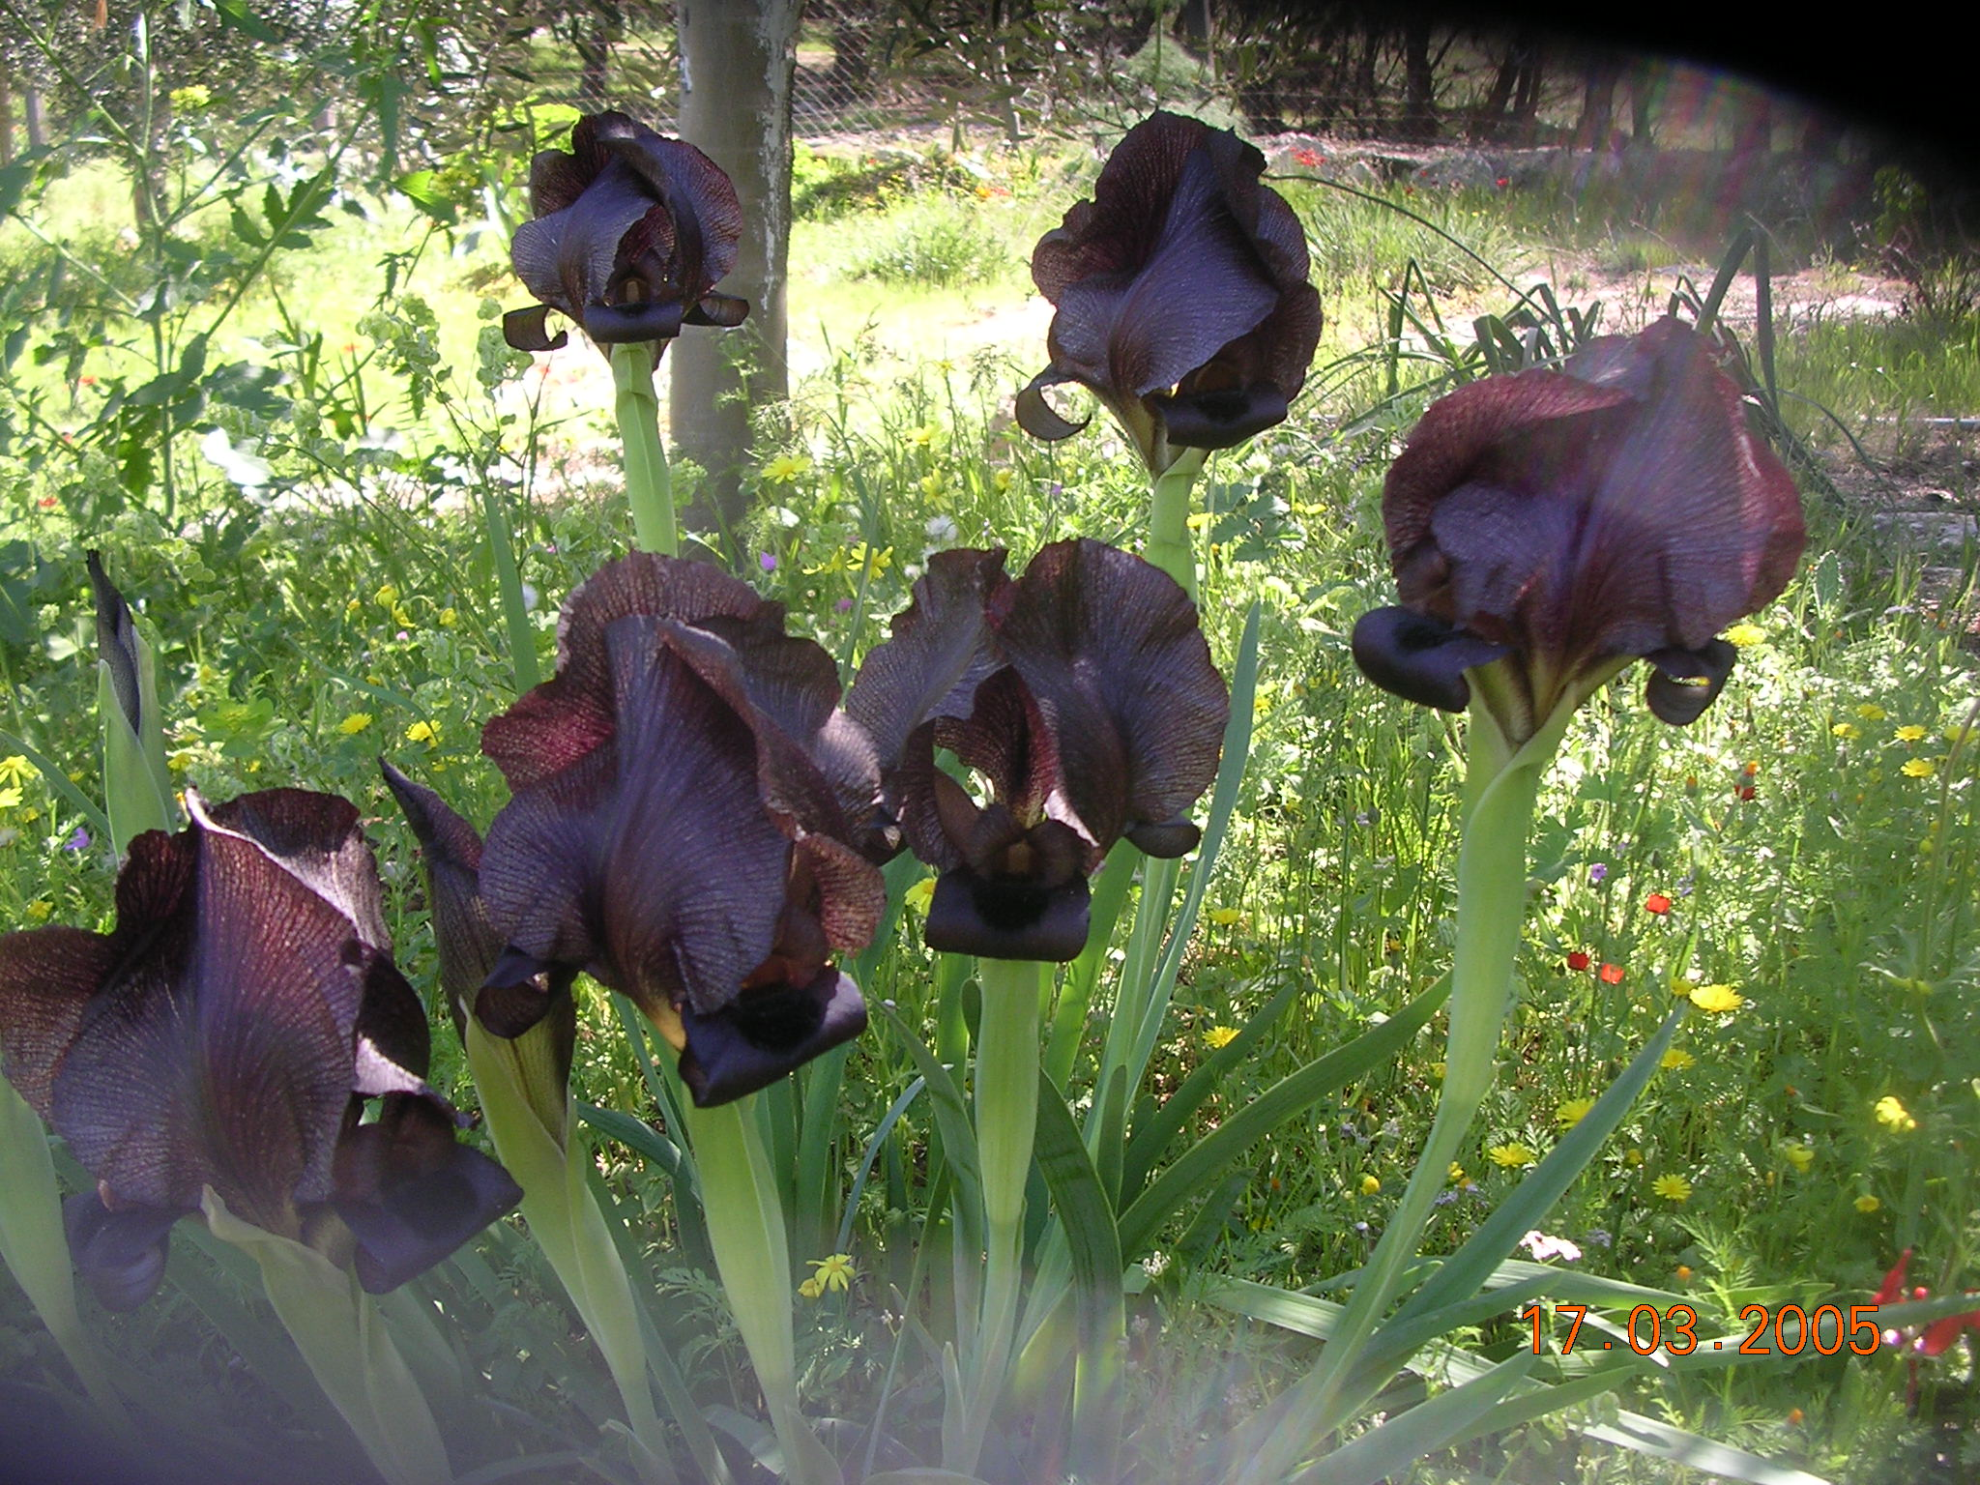
Thank You

